Slide 1
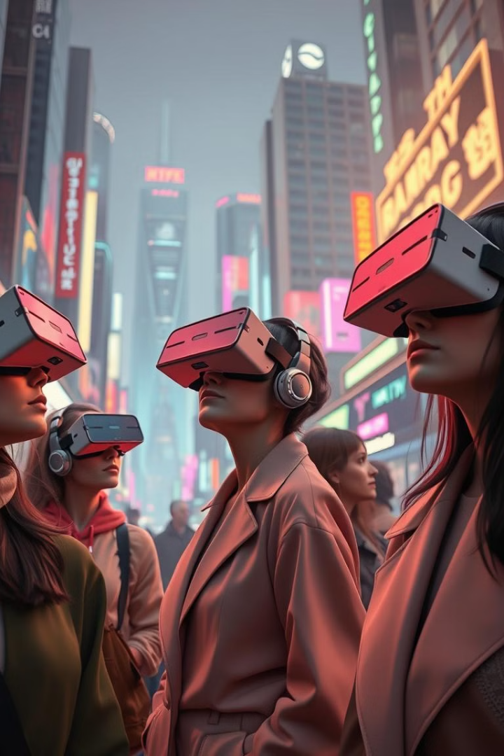
Immersive Realities: Exploring the World of Virtual Reality
Virtual Reality (VR) transports users to simulated worlds. It offers experiences ranging from gaming to education. This presentation explores the core concepts and diverse applications. We will cover benefits and challenges of VR technology.

Slide 2
What is Virtual Reality?
Definition
Key Concepts
VR creates immersive, interactive experiences. Users perceive and interact within a simulated environment.
Immersion: Feeling present in the virtual world.
Interaction: Engaging with the environment.
Sensory Feedback: Receiving visual, auditory, or haptic stimuli.

Slide 3
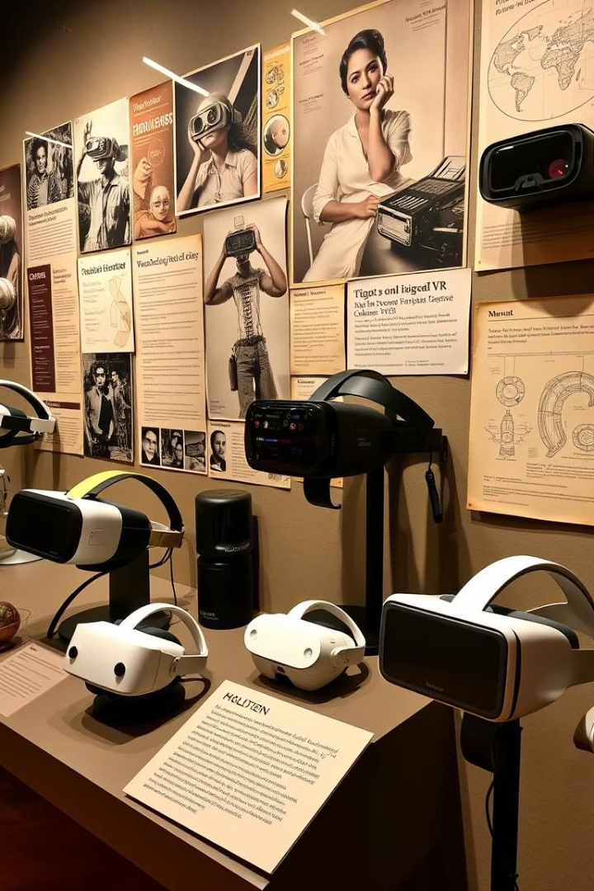
A Brief History of VR
1
1960s
Sensorama: Morton Heilig's multi-sensory theater stimulated multiple senses.
2
1980s
Early VR Systems: VPL Research created VR goggles and the Data Glove.
3
1990s
Commercial VR: VR gaming arcades and entertainment systems emerged.
4
2010s-Present
Modern VR: Oculus, HTC, and others brought VR to consumers' homes. Ongoing innovation continues!

Slide 4
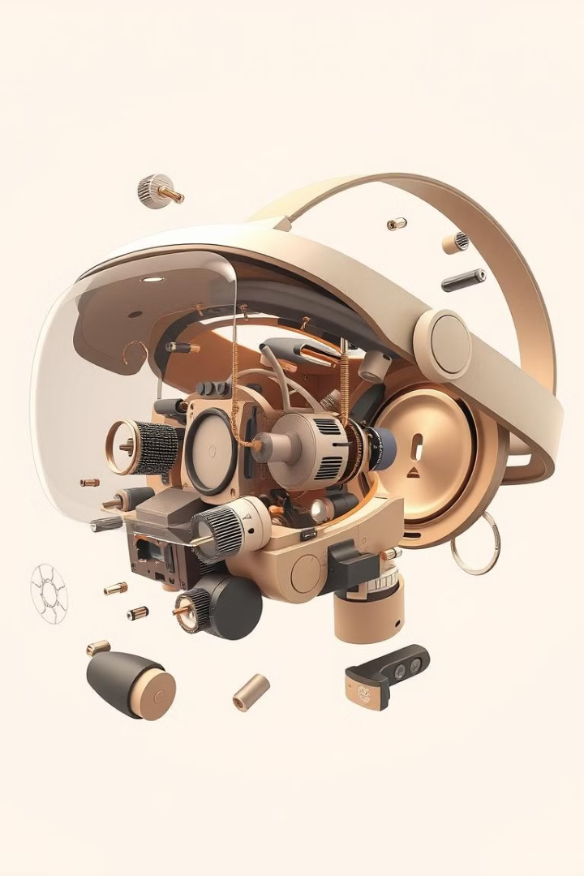



How VR Works
Head-Mounted Display (HMD)
Controllers
Tracking Systems
Allow users to interact with the virtual world.
Displays the virtual environment to the user's eyes.
Monitor the user's movements for accurate VR experience.

Slide 5
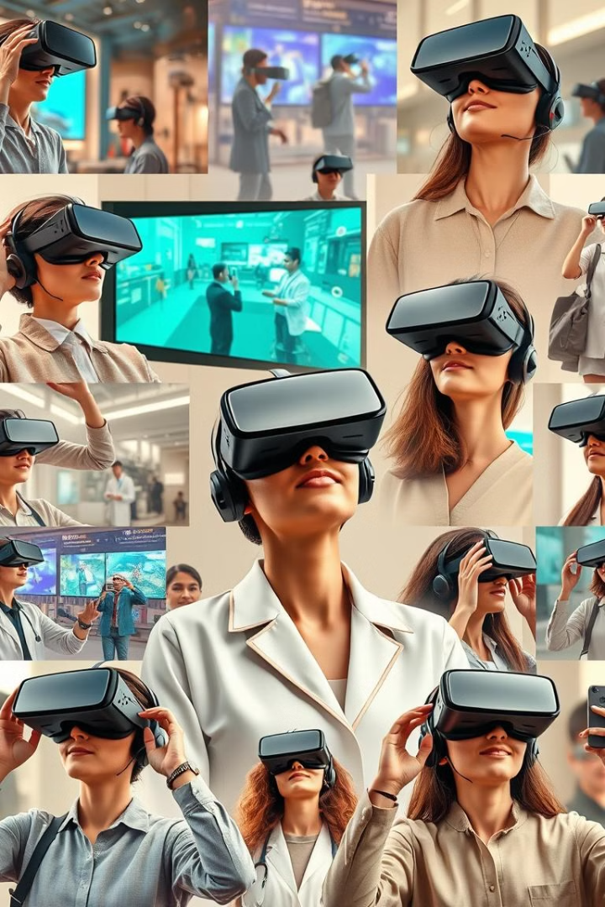
Applications of VR
Gaming
Immersive gaming experiences with realistic environments.
Education
Virtual field trips and interactive learning modules.
Healthcare
Surgical training, therapy, and rehabilitation.
Training
Safe simulation of dangerous or complex scenarios.

Slide 6

The Benefits of VR
1
Immersion
2
Training
3
Accessibility
Users feel truly present in the virtual world.
Safe and cost-effective simulations for skill development.
Provides experiences for those with physical limitations.

Slide 7



The Challenges of VR
Comfort
2
Motion sickness and physical discomfort can occur.
Cost
1
High upfront expenses for hardware and software.
Content
Limited availability of high-quality, engaging content.
3

Slide 8
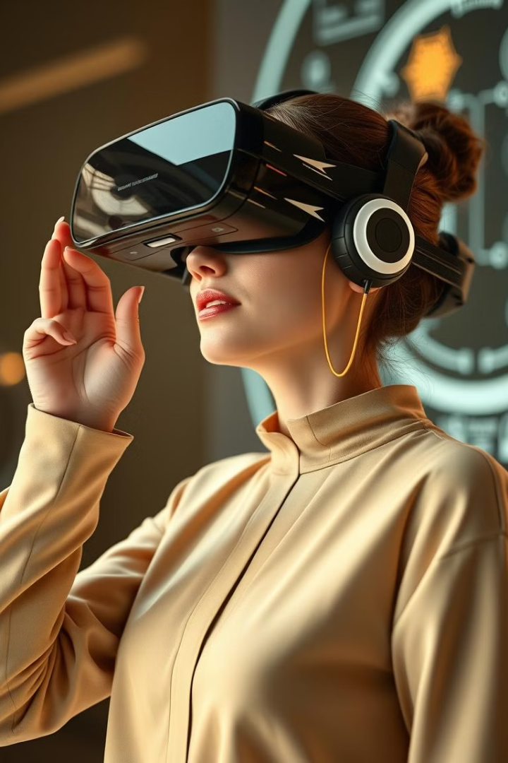




The Future of VR
Enhanced Immersion
Improved graphics and more realistic sensory feedback.
Wireless VR
Untethered headsets for greater freedom of movement.
AR Integration
Blending virtual and augmented reality experiences.
Wider Adoption
VR becoming more accessible and mainstream.

